Slide 1
Entrepreneurship BS-CS – Spring 2022
Salmaan Rahman
Lecture 5
The Business Plan

Slide 2
New Business Ventures
Steps of a well defined process:
Recognize a business idea
Test the feasibility
Write a business plan
Launch the business

Slide 3
Developing our business plan
A feasibility study begins with collecting all the background information we can (secondary research)
Secondary research provides us with general information about the idea, the environment, and some information about our specific idea
Collecting as much information as possible allows us to be more specific as we design our primary research
Primary research is conducted after secondary research
Primary research provides very specific information about our specific business plan : Product, technical, industry/market, organizational and financial feasibility
Once this information is gathered and analyzed, we can develop a formal business plan

Slide 4
Writing a Business Plan:
“Without a strategy, an organization is like a ship without a rudder, going around in circles when it isn't at the mercy of prevailing winds”
Planning is a never-ending process in growing businesses and helps to integrate and coordinate work activities
Planning is one of the 4 main functions of management and involves:
defining an organization’s goals,
establishing strategies to fulfill those goals
Developing plans

Slide 5
Writing a business plan Why Plan?
Planning
Provides a common direction to all aspects of the organization
Reduces uncertainty by focusing attention on what’s ahead
Minimizes waste and redundancy
Maximizes efficiency and effectiveness
Provides the framework for all managerial functions:
Leading, organizing, establishing goals and standards used in controlling

Slide 6
Writing a business plan Why Plan?
Internal reasons:
Forces the founding team to systematically think through every aspect of its new venture
External reason:
Communicates the merits of a new venture to outsiders, such as investors and bankers

Slide 7
Writing a business plan Why Plan?
Plans identify goals – and the strategies (plans) needed to achieve those goals
All organizations have multiple goals (objectives)
Stated goals: formal goals as stated in company documents
Nike: to inspire and innovate athletes
Real goals: what the organization actually pursues
Usually profit
Most company goals can be classified as either strategic or financial
Financial: related to company financial performance
Strategic: related to other aspects of the company’s performance
Market share, position, etc

Slide 8
The Business Plan
A written document prepared by the entrepreneur that describes all the internal and external elements involved in starting the new venture.
An integration of all the different functional plans
Defines business objectives and strategies
Essentially a road map of the first 1- 3 years

Slide 9
Writing a business plan Why Plan?
A good business plan is expected to address the needs of a wide variety of people
Investors
Employees
Suppliers
Customers
Advisors
Consultants

Slide 10
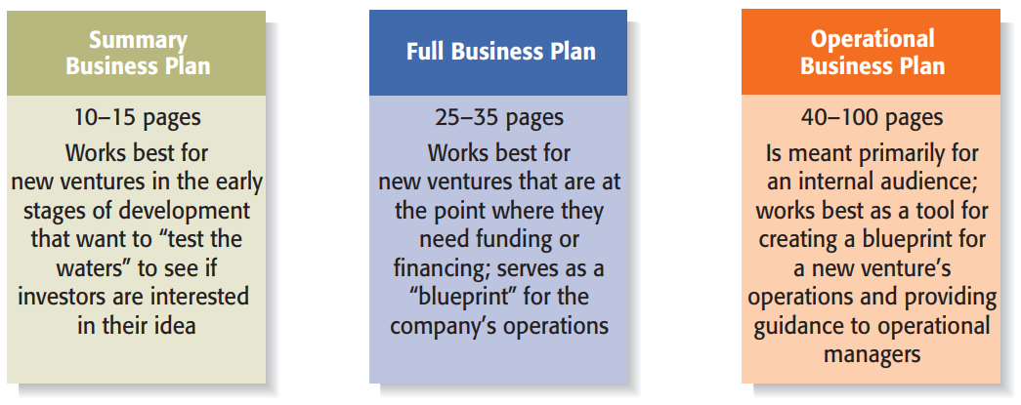
Types of Business Plans:

Slide 11
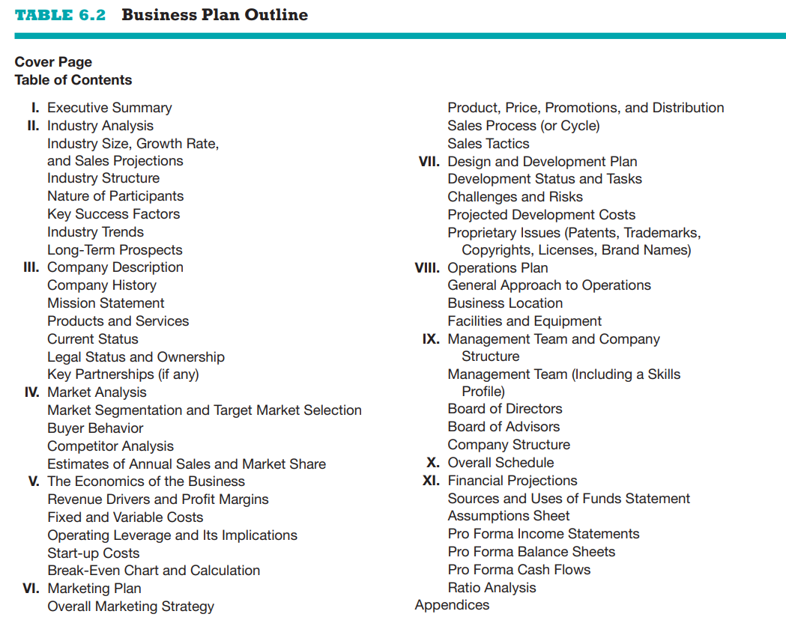

Slide 12
Sections of the Business Plan:
Cover Page and Table of Contents:
Include the company’s name, address, and phone number
a land-based phone number, an e-mail address, and a smartphone number. This information should be centered at the top of the page
the date
contact information for the lead entrepreneur
company’s website address (also, Facebook page and Twitter name)
Bottom of the cover page should include information alerting the reader to the confidential nature of the plan.
If the company already has a distinctive trademark, it should be placed somewhere near the center of the page.
A table of contents should follow the cover letter. It should list the sections and page numbers of the business plan and the appendices.

Slide 13
Sections of the Business Plan (I):
Executive Summary:
The executive summary is a short overview of the entire business plan; it provides a busy reader with everything she needs to know about the new venture’s distinctive nature
an executive summary is that it is not an introduction or preface to the business plan; instead, it is meant to be a summary of the plan itself.
Should not be more than two single-spaced pages.
Provide an overview of the business plan on a section-by-section basis in the same order as presented in the business plan.
EC should be written last – after changes/editing to plan have been done

Slide 14
Sections of the Business Plan (II):
Industry analysis:
Describes the industry in which the firm intends to compete.
Description should include data and information about various characteristics of the industry, such as its size, growth rate, sales projections, promising areas and points of vulnerability
Industry trends – both environmental and business trends
Environmental trends: economic, social, technological advances, political and regulatory changes.
Business trends: profit margins , input costs
Conclude with a brief statement of your beliefs regarding the long-term prospects for the industry.
Objective is for reader to visualize how your firm will fit in or see the gap that your firm will fill.

Slide 15
Market Information Needs The inverted pyramid
General Environmental and Demographic Trends
National Industry Trends
Local Competition (strengths and weaknesses)
Local Environmental and Demographic trends
Local Industry Trends
Goals & Objectives

Slide 16
Sections of the Business Plan (III):
Company Description:
A general description of the company.
The company history section should be brief, but should explain where the idea for the company came from and the driving force behind its inception.
A mission statement
defines why a company exists and what it aspires to become.
Products and services section:
Explanation of product or service. Include description of product or service uniqueness and plans to position it in marketplace relative to its rivals. (ideal place to start reporting the results of feasibility analysis.
Current status section:
far along company is in its development.
selected and registered your company’s name, established legal entity
completed a feasibility analysis,
developed a business model,
Legal status and ownership section:
Indicate who owns the business and how the ownership is split up
Any key partnerships that are integral to the business
E.g other businesses, suppliers, retailers etc.

Slide 17
Sections of the Business Plan (IV):
Market analysis:
Market analysis is different from industry analysis
Industry analysis focuses on the industry in which a firm intends to compete (e.g., toy industry, fitness center industry, men’s clothing industry),
Market analysis identifies the specific target market on which company will focus. This is done through Market segmentation.
by geography (city, state, country),
demographic variables (age, gender, income),
psychographic variables (personality, lifestyle, values)
A competitor analysis, which is a detailed analysis of a firm’s competitors, should be included

Slide 18
Sections of the Business Plan (IV):
Market Analysis (cont):
Final section should include annual sales projections and estimated market share
Sales projections are made by:
Multiplication Method:
Top down approach: usually for national projections: estimate the total number of users of the product, estimate the average price customers pay, and estimate what percentage of the market your business will garner
Bottom up Approach: local projections: determine how many customers to expect and the average amount each customer will spend
Comparative firm analysis:
Find a comparable firm and ask/estimate customer numbers and annual sales
Trade associations
Internet researches

Slide 19
Sections of the Business Plan (V):
Economics of the Business:
Financial analysis of a business, addresses the basic logic of how profits are earned in the business and how many units of a business’s product or service must be sold for the business to “break even” and then start earning a profit.
Identifies
Major revenue drivers
Single driver: one product
Two drivers: product + service guarantee

Slide 20
Sections of the Business Plan (V) :
Economics of the Business (cont):
Costing:
Gross Margins: selling price minus the cost of goods sold or variable costs. (Costs of goods sold = materials and direct labor needed to produce the revenue driver)
Contribution Margin: Part of the gross margin that goes to cover fixed costs and profits
Fixed and variable cost:
variable costs: vary by number of sales
Fixed costs: costs whether a company sells something or not.
Operating leverage: ratio of fixed versus variable costs.
Start-up costs usually one-time expenses
legal expenses, fees for business licenses and permits, website design, business logo design
This section should conclude with a break-even analysis, which is an analysis of how many units of its product a business must sell before it breaks even and starts earning a profit

Slide 21
Sections of the Business Plan (VI):
Marketing Plan:
Focuses on how the business will market and sell its product or service (Marketing Strategy)
price, promotion, distribution, and sales, positioning, and points of differentiation
Sales Process
Sales Tactics

Slide 22
Sections of the Business Plan (VII):
Product/ Service Design & Development Plan
If developing a completely new product or service
Identifies status (present stage) of development efforts:
product conception
prototype
initial production
full production.
Provide a timeline that describes any remaining steps.
Prototype
Used for testing and feedback
A prototype for a Web-based company might consist of a preliminary or beta version of the site, with sufficient functionality built into the site for users
Virtual prototype - a computer-generated 3D image of a product or service idea.
“Challenges and Risks” should be included.
Conclude with patents, trademarks, copyrights, or trade secrets that have been secured or are planned to be secured

Slide 23
Sections of the Business Plan (VIII):
Operations Plan:
Outlines how business will be run and how product or service will be produced.
Can be framed in terms of
“back stage,” or behind-the-scenes activities
“front stage,” or what the customer sees and experiences
Identify key experiences rather than details
Business location(s)
Facilities and equipment

Slide 24
Sections of the Business Plan (IX):
Key personnel and staffing
Management Team and Company Structure
Brief profile of each member of the management team, starting with founder or founders
Title of the position
Duties and responsibilities of the position
Previous industry and related experience
Previous successes
Educational background
List of board of directors and advisors (if needed)
Organizational Chart and company structure
graphic representation of how authority and responsibility are distributed within the company

Slide 25
Sections of the Business Plan (X):
Overall Schedule:
Timeline of major events required to launch the business.
Typical milestones
incorporating venture,
completion of prototypes,
rental of facilities,
obtaining critical financing,
starting the production of operations,
obtaining the first sale

Slide 26
Sections of the Business Plan (XI):
Financial Projections:
Typically includes:
A sources and uses of funds statement - document that lays out how much money a firm needs, where the money will come from, and how the money will be used.
Pro forma financial statements
pro forma income statement
pro forma balance sheet
pro forma cash flow statement
Ratio analysis
Return on assets
Return on sales.

Slide 27
Sections of the Business Plan:
Appendix:
Any material that does not easily fit into the body of a business plan
Resumes of the top management team,
photos or diagrams of product or product prototypes, certain financial data.
Full tables and spreadsheets if needed.
market research projections

